Slide 1
Swelling
Courtesy of Lorenzo Malebra, SCK-CEN

Slide 2
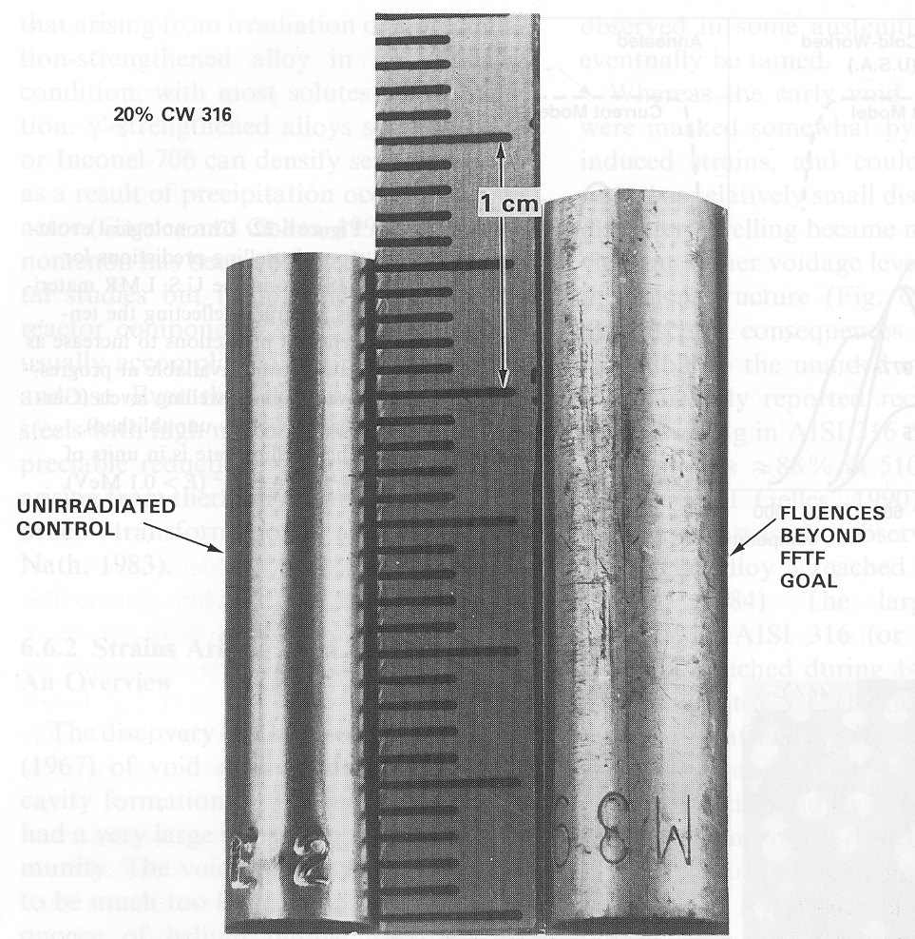
What is swelling?
After irradiation
Before irradiation
Hardly any swelling is expected in LWRs
‘low’ temperatures
Effect will be important in GenIV reactors
temperatures of 400°C to 700°C
flux ≈ 100 flux LWR

Slide 3
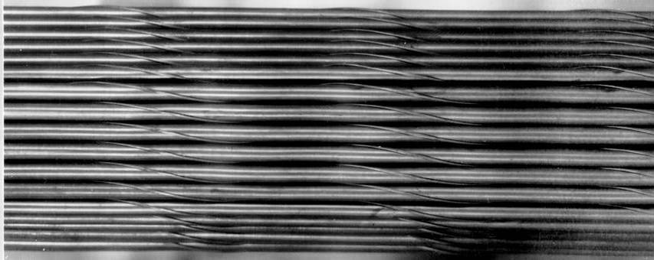
Consequences of swelling
Annealed wire wrap spacer used on fuel pins assemblies in BN-600 (Russian sodium-cooled fast breeder reactor) – before irradiation
Spiral wrapped wire
Chuev, Lanskykh, Ogorodov, Sheikmann, Sergeev, 2004

Slide 4
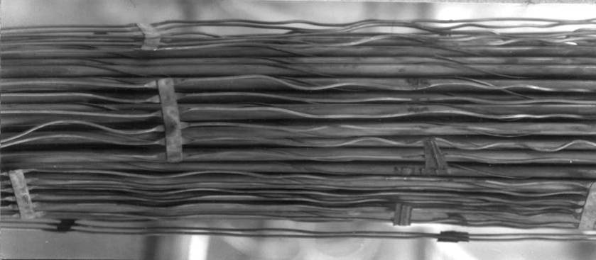
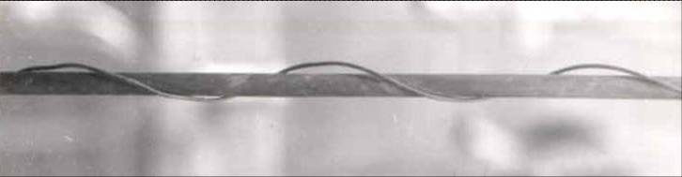
Consequences of swelling
Annealed wire wrap spacer used on fuel pins assemblies in BN-600 (Russian sodium-cooled fast breeder reactor) – after irradiation
Wire swelled more than cladding.
Chuev, Lanskykh, Ogorodov, Sheikmann, Sergeev, 2004

Slide 5
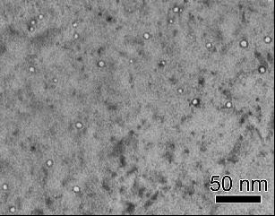
What is swelling really?
Voids observed in a cold-worked 316 stainless steel baffle bolt from Tihange 1 (Belgian nuclear power plant) Thomas and Bruemmer, 2002
8.5 dpa, ~299ºC
Hardly any macroscopic swelling observed
5

Slide 6
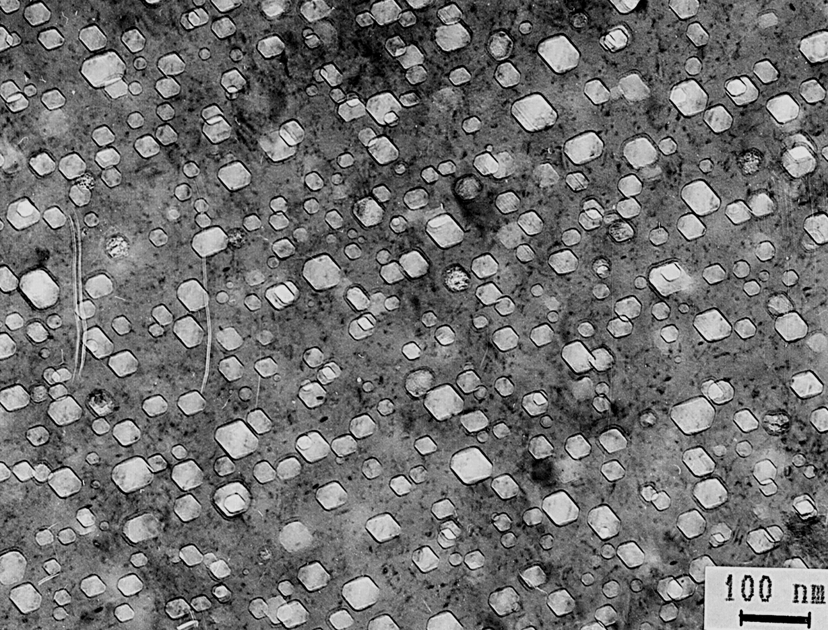
What is swelling really?
Voids observed in stainless steel after 73 dpa at 335ºC in BN-350 sodium fast reactor (Kazakhstan) Porollo, Konobeev, Garner, 2000
1.4 x 10⁻⁶ dpa/sec
6.2% swelling
6

Slide 7
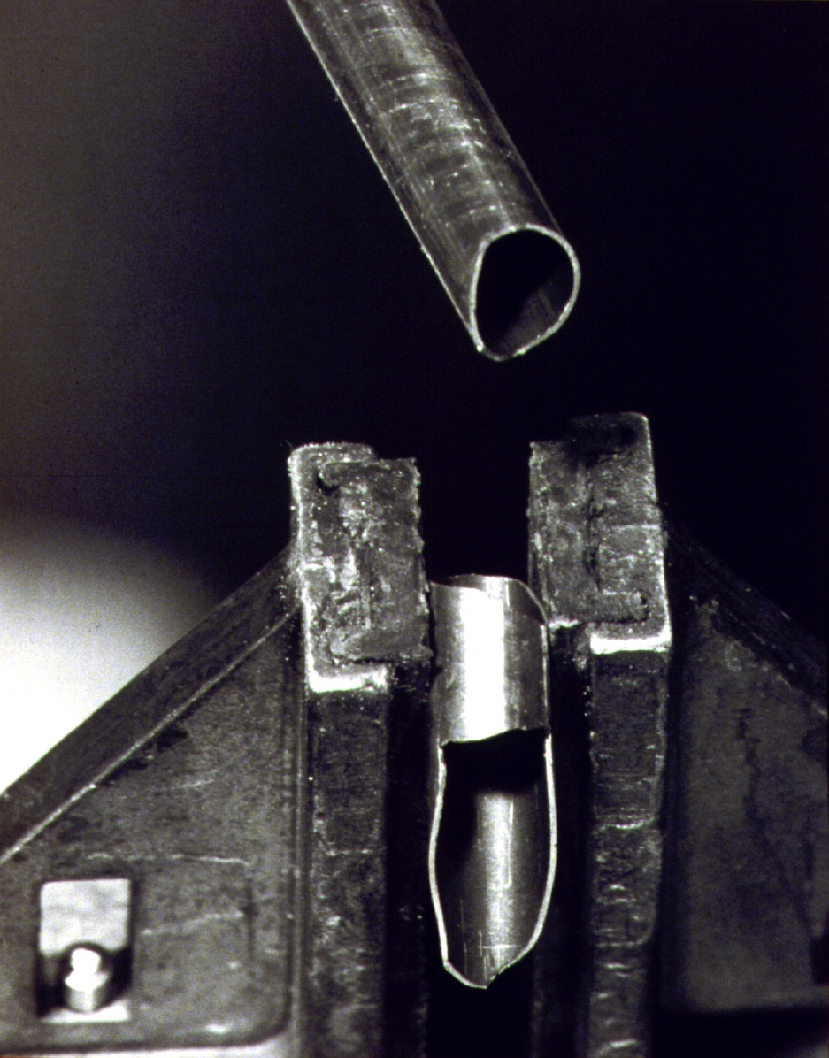
Another consequence of swelling: Void-induced embrittlement
14% swelling in 316 stainless steel irradiated at ~400ºC
Failure occurred during clamping at room temperature.
Porter and Garner, 1988
7

Slide 8
Which variables affect swelling?
Transient regime:
Material and composition
Phase distribution
Temperature
Dpa-rate
Stresses
Steady-state swelling rate:
Almost material’s constant eventually always reached in steels: 1%/dpa (austenitics); 0.2%/dpa (F/M)
Incubation dose

Slide 9
How can we explain swelling ?
Vacancies and self-interstitials are produced in the same quantity by neutrons
Why only/mainly voids are observed in swollen metals ?
What happened with the self-interstitials?
Volume seems to increase if voids are formed inside the material
Voids in themselves decrease the macrosopic volume
But how was matter removed from the voids and brought somewhere else?

Slide 10


Dynamic bias
Self-interstitial
Self-interstitials migrate faster than vacancies
C_{V}
Concentration
Vacancy
C_{SIA}
Time (dose)
At steady state, more SIAs disappear at sinks than vacancies
So vacancy concentration is higher

Slide 11
Dislocation bias
Self-interstitials interact at larger distance than vacancies with dislocations
They are absorbed more efficiently than vacancies
This leads to an even larger difference in concentration of the two species
SIA
Capture radius for SIA
r_{SIA}
Dislocation line
r_{V}
Capture radius for vacancy
vacancy

Slide 12
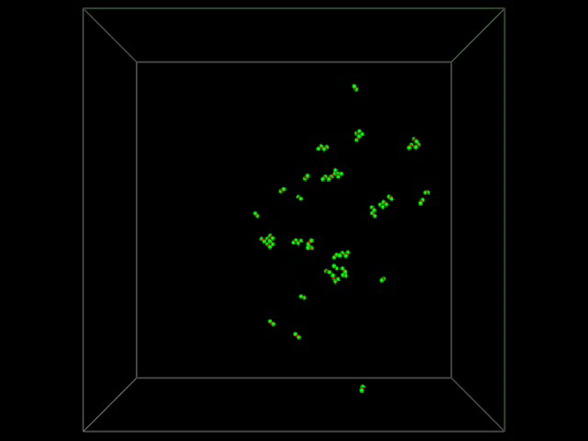
Production bias
Vacancies are produced at the core of the cascade
SIAs are produced at the periphery of the cascade, in fairly large clusters
Vacancy clusters diffuse very slowly in 3D
SIA clusters diffuse fast in 1D
⇒ Separation of the two populations

Slide 13
A plausible mechanism for swelling
Swelling =
Transport of matter from bulk to sinks with cavity creation
sink
void
<111> (bcc) or <110> (fcc)
cascade
SIA cluster (loop)

Slide 14
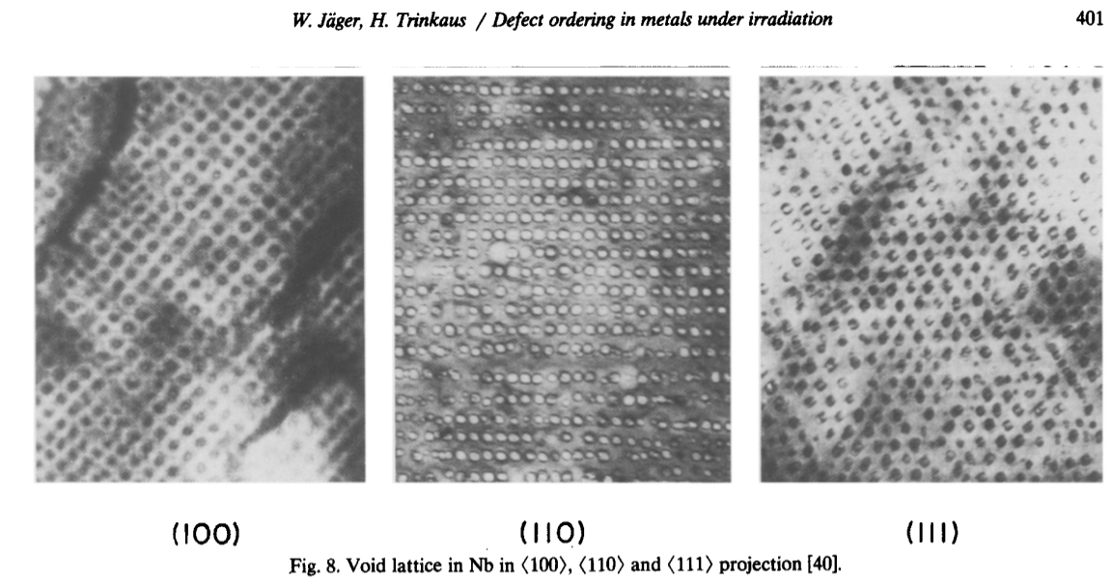
Void lattices
A pattern of voids can appear after high dose neutron irradiation – with the same structure as the underlying lattice!

Slide 15
Take home messages
Swelling is a macroscopic change of volume observed in irradiated materials under certain conditions, generally accompanied by observation of voids inside the material
Versus dose, it is characterised by a transient regime and a steady state regime
Extension of transient regime (incubation dose) depends on many variables: type of material, composition, phase distribution, temperature, dpa-rate, stresses, …
Steady-state regime swelling rate is more or less a materials constant always reached eventually
Swelling can be explained in terms of biases, i.e. different properties of vacancy and SIA type defects leading to a partition of the two populations, with SIAs absorbed at sinks and vacancies forming voids inside the materials

